Slide 1
Splunk: Reports, Statistics, Dashboards and Visualizations
SIEMS, Day 3

Slide 2
Class Objectives
By the end of class today, you will be able to:
Use Splunk’s documentation to implement new search commands.
Generate and use reports from Intrusion Prevention System logs.
Perform statistical analysis based on event information.
Use dashboards to accelerate time-to-insight and time-to-action.
Use visualization to compare and aggregate event field data.

Slide 3
Day 2 Recap
Last class, we used Splunk to investigate if brute force attacks were occuring at a website.
We looked at the volume of activity at the site and developed a baseline and threshold.
A baseline differentiates between a real attack and normal daily activity.
A threshold is the volume of activity at which an alert is triggered.

Slide 4
Day 2 Recap
Last class, we used Splunk to investigate if brute force attacks were occuring at a website.
We looked at the volume of activity at the site and developed a baseline and threshold.
A baseline differentiates between a real attack and normal daily activity.
A threshold is the volume of activity at which an alert is triggered.
In the first exercise of the day, you will investigate the target of the suspicious activity by looking at the relationship between locked accounts and account and domain names.
Security teams use Splunk’s contingency command to create a contingency table to show the relationship between fields in an event.
These tables help determine root causes, analyze patterns for advanced threat detection, and discover threat actors.

Slide 5
Activity: Contingency Command Warm-Up
In this activity, you will investigate locked accounts using the contingency command.
Instructions sent via Slack.
20 Minutes

Slide 6
Contingency Command Warm-Up

Slide 7
Contingency Warm-Up Review
Write an SPL command that will search for locked accounts.

Slide 8
Contingency Warm-Up Review
Write an SPL command that will search for locked accounts.
Answers may vary:
source=”wineventlogs_baseline.csv “locked”

Slide 9
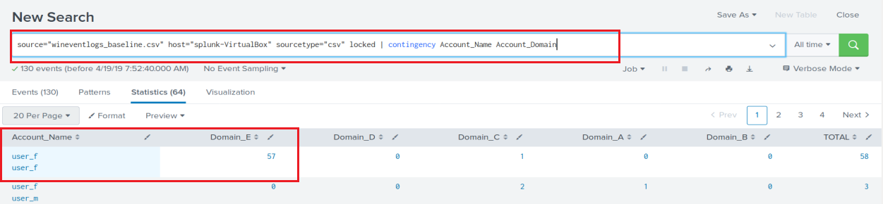
Contingency Warm-Up Review
Contingency tables can be used to detect abnormal activity.
The locked search uses a pipe with the contingency command to gather the search results.
source=“wineventlogs_baseline.csv” host=”=“splunk-VirtualBox” sourcetype=“csv” locked | contingency Account_Name Account_Domain

Slide 10
Contingency Warm-Up Review
Where was the attacker trying to gain access?

Slide 11
Contingency Warm-Up Review
Where was the attacker trying to gain access?
User_f and Domain_E, which showed 57 locked events.

Slide 12
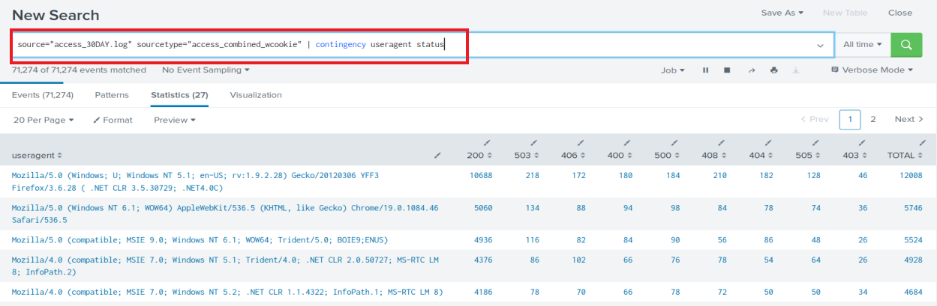
Contingency Warm-Up Review
Additional Challenge: Using the access_30DAY.log file, give another example of where a contingency table can be used such as User agent and status analysis.

Slide 13
Generating Reports in Splunk

Slide 14
Generating Reports in Splunk
Reports are created when you save a search.
Each report contains the events, field and statistical data that was generated from running the SPL search command.
Reports can be run anytime and they fetch fresh search results each time they run.
Reports can be scheduled to run at any interval .
Reports show statistics and visualizations. They can also be used in dashboards.
Reports can be run as historical searches during a security incident investigation.

Slide 15
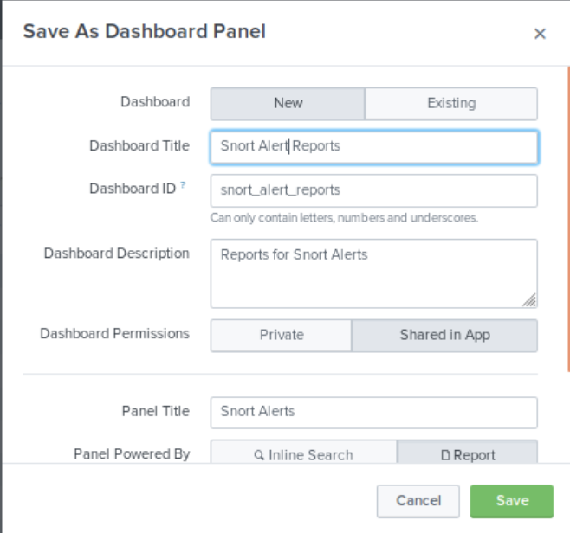
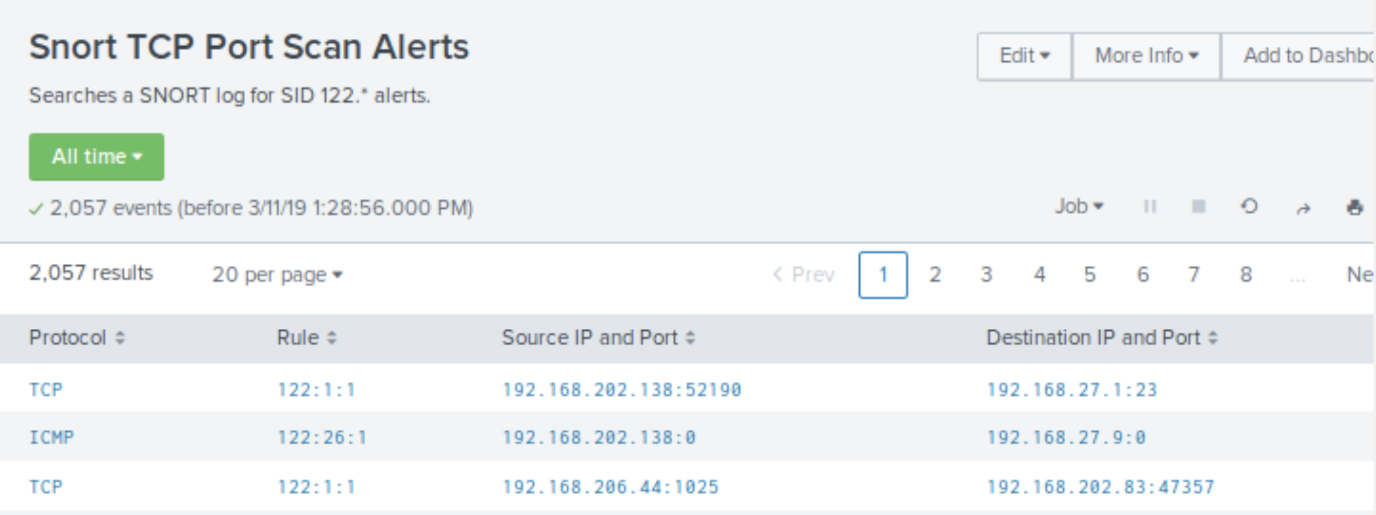
Reports and Dashboards Demo
Now that you’re more familiar with searching in Splunk, the next step is creating reports and dashboards from search results.
Saving a Search as a Report
Adding a Report to a Dashboard
Viewing a Report in a Dashboard
Adding an Existing Search to a Dashboard
Saving the Report to the Snort Alert Dashboard

Slide 16
Generate a Report for Failed Login Attempts

Slide 17
Introduction to the Next Activity:
In the next activity, you will pair up and create a statistical report to analyze events from Intrusion Prevention System(IPS) logs from the Fortinet Security System.
Fortinet provides network, firewall, application and endpoint/device security solutions that can be integrated with Splunk Enterprise.
What is the difference between an IDS and an IPS?

Slide 18
Introduction to the Next Activity:
In the next activity, you will pair up and create a statistical report to analyze events from Intrusion Prevention System(IPS) logs from the Fortinet Security System.
Fortinet provides network, firewall, application and endpoint/device security solutions that can be integrated with Splunk Enterprise.
What is the difference between an IDS and an IPS?
IDS simply monitors where as an IPS can prevent a packet from delivery.

Slide 19

Introduction to the Next Activity:
In the next activity, you will pair up and create a statistical report to analyze events from Intrusion Prevention System(IPS) logs from the Fortinet Security System.
Fortinet provides network, firewall, application and endpoint/device security solutions that can be integrated with Splunk Enterprise.
What is the difference between an IDS and an IPS?
IDS simply monitors where as an IPS can prevent a packet from delivery.
This activity contains a new command called stats, which generates a report that displays summary statistics. Searches return the sum, count, or average of event field data.

Slide 20
Activity: Generating a Statistical Report from Firewall Attack Logs
In this activity, you will create a statistical report to analyze events from Intrusion Prevention System logs.
Instructions sent via Slack.
20 Minutes

Slide 21
Generating Statistical Report from Firewall Attack Logs

Slide 22
Activity Review
There was a lot of information in the attack log for each event. Splunk quickly indexed and extracted the metadata field data.
stats by count <field>, <field>, <field>...
stats is the Splunk command.
count provides the number of events.
field is a field in the event
This is another SPL command that takes the input from a previous command via a pipe.
The command also takes arguments such as sum or average.
Example: | stats by count “scr_ip”, “dst_ip”

Slide 23
Activity Review Part 1: Creating the Search
What fields contain the years for the attack?
Which fields contain the months for the attack?
What is the attack name?
Using the NIST National Vulnerability Database, what does the attack do?

Slide 24
Activity Review Part 1: Creating the Search
What fields contain the years for the attack?
date_year
Which fields contain the months for the attack?
What is the attack name?
Using the NIST National Vulnerability Database, what does the attack do?

Slide 25
Activity Review Part 1: Creating the Search
What fields contain the years for the attack?
date_year
Which fields contain the months for the attack?
date_month
What is the attack name?
Using the NIST National Vulnerability Database, what does the attack do?

Slide 26
Activity Review Part 1: Creating the Search
What fields contain the years for the attack?
date_year
Which fields contain the months for the attack?
date_month
What is the attack name?
Oracle.9i,TNS.OneByte.Dos
Using the NIST National Vulnerability Database, what does the attack do?

Slide 27
Activity Review Part 1: Creating the Search
What fields contain the years for the attack?
date_year
Which fields contain the months for the attack?
date_month
What is the attack name?
Oracle.9i,TNS.OneByte.Dos
Using the NIST National Vulnerability Database, what does the attack do?
“The Transparent Network Substrate (TNS) Listener in Oracle 9i 9.0.1.1 allows remote attackers to cause a denial of service (CPU consumption) via a single malformed TCP packet to port 1521.”

Slide 28
Activity Review Part 1: Creating the Search
Create an SPL search command that searches the firewall IPS event logs using the attack name and returns:
The count of attacks by year and month
Then sorts the counts in descending order
Executes the search using All Time.

Slide 29
Activity Review Part 1: Creating the Search
Create an SPL search command that searches the firewall IPS event logs using the attack name and returns:
The count of attacks by year and month
Then sorts the counts in descending order
Executes the search using All Time.
Add the SPL stats and sort command:
|stats count by date_year, date_month | sort - count
fortinet_logs.csv attack_name=”Oracle.9i.TNS.OneByte.DoS” | stats count by date_year, date_month | sort - count

Slide 30
Activity Review Part 2 and 3
2. Creating the Statistical Report
Save the search as a Report with the titler OPS115: Firewall IPS Report
3. Find and Display the Report in the Reports list

Slide 31
Activity Review Part 2 and 3
2. Creating the Statistical Report
Save the search as a Report with the titler OPS115: Firewall IPS Report
Click on Save As > Report. Give it a title of OPS115:Firewall IPS Report
3. Find and Display the Report in the Reports list

Slide 32
Activity Review Part 2 and 3
2. Creating the Statistical Report
Save the search as a Report with the titler OPS115: Firewall IPS Report
Click on Save As > Report. Give it a title of OPS115:Firewall IPS Report
3. Find and Display the Report in the Reports list
Select the Report tab located in the App bar.
Click the Report Title (OPS115: Firewall IPS Report) and Open in Search

Slide 33
Activity Review: Extra Challenge and Report Results
4. How would you obtain the total number of attacks for each month of each year in the attack log?
5. What month(s) and year(s) had the most attacks?

Slide 34
Activity Review: Extra Challenge and Report Results
4. How would you obtain the total number of attacks for each month of each year in the attack log?
Change the sort to “sort - date_month”
source=”foritnet_logs.csv attack_name=“Oracle.9i.TNS.OneByte.DoS” | stats count by date_year, date_month | sort - date_month
5. What month(s) and year(s) had the most attacks?

Slide 35
Activity Review: Extra Challenge and Report Results
4. How would you obtain the total number of attacks for each month of each year in the attack log?
Change the sort to “sort - date_month”
source=”foritnet_logs.csv attack_name=“Oracle.9i.TNS.OneByte.DoS” | stats count by date_year, date_month | sot - date_month
5. What month(s) and year(s) had the most attacks?
March 2019

Slide 37
Working with Splunk Dashboards

Slide 38
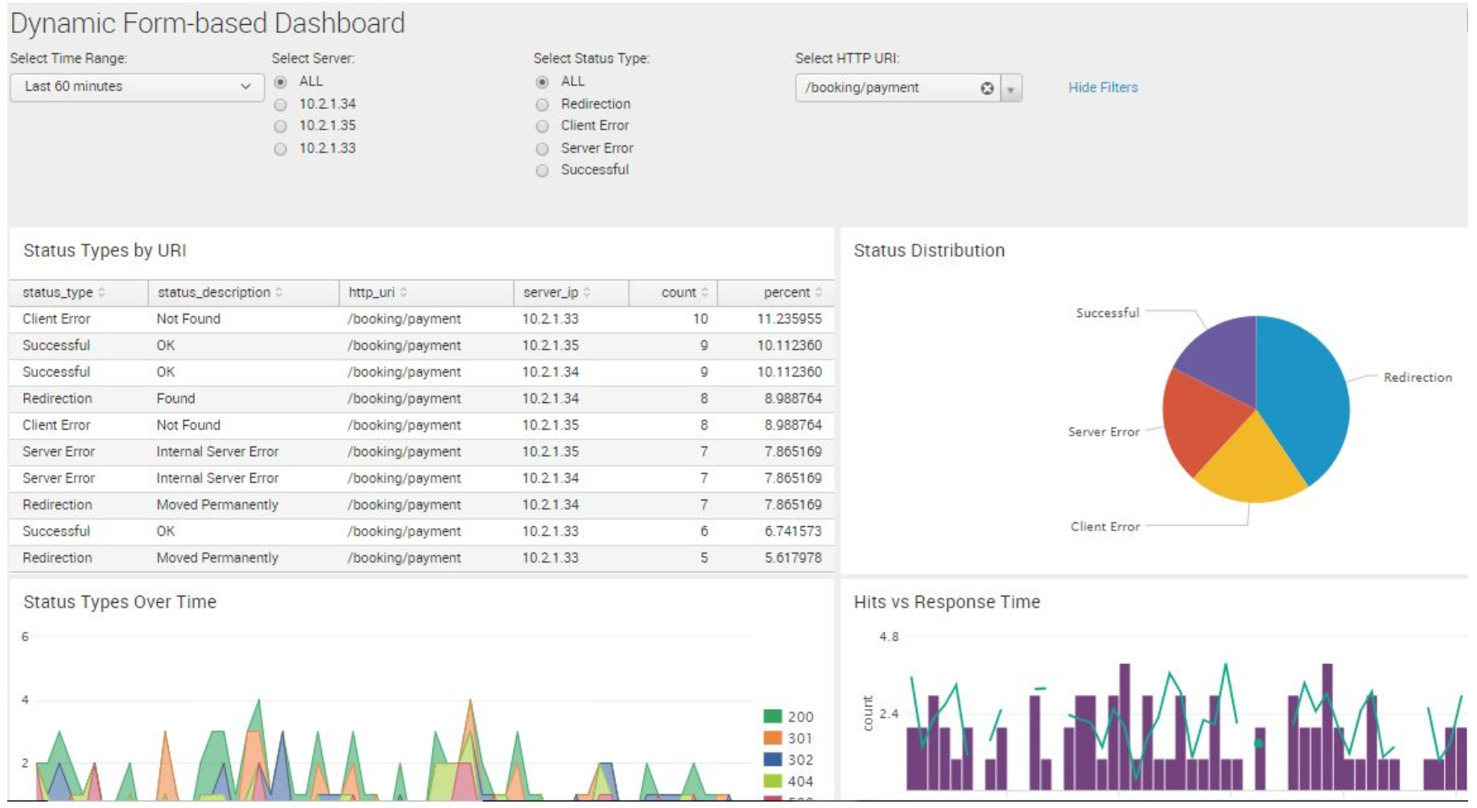
Splunk Dashboards
Dashboards integrate elements in panels to display the most relevant information for different teams and use cases.
Dynamic form-based dashboards allow for modifications using radio, buttons, and check boxes.
Real-time dashboards are displayed on panel
screens for constant viewing in network and
security operations centers.
Dashboards as scheduled reports can be
saved as a PDF file or sent as emails to
NOC or SOC teams at scheduled.

Slide 39
Adding an Existing Search to a Dashboard

Slide 40
Activity: Create a Dashboard for Failed Password Attempts
In this activity, you will create a Linux and Windows Failed Password Dashboard for Monitoring login attempts by an SOC Team.
Instructions sent via Slack.
15 Minutes

Slide 41
Create a Dashboard for Failed Password Attempts

Slide 42
Activity Review Part 1: Creating a Search and Report
Which SPL command was used to search for all failed password attempts?

Slide 43
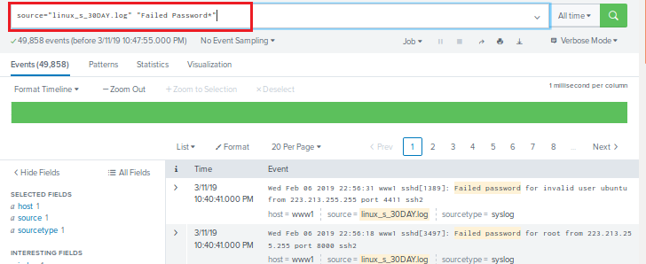
Activity Review Part 1: Creating a Search and Report
Which SPL command was used to search for all failed password attempts?
Attach Failed Password to the SPL search command.

Slide 44
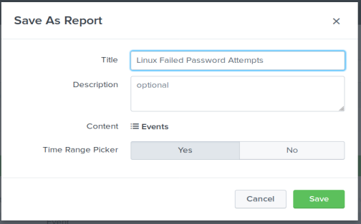
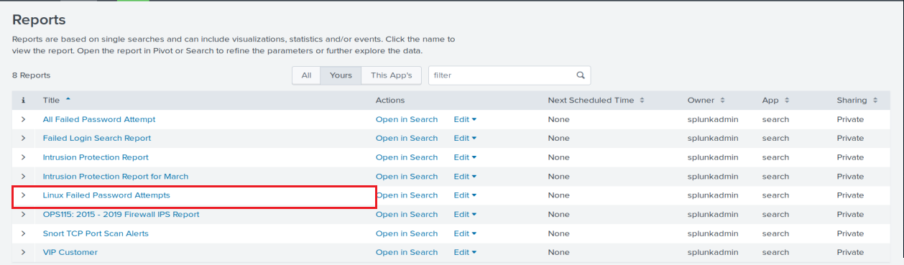
Activity Review Part 1: Creating a Search and Report
Save the search as a Report with Title = Linux Failed Password Attempts
Save and view the report.
Locate the Report in the Report List and execute the search by selecting Open in Search.

Slide 45
Activity Review Part 2: Creating a New Dashboard for Report
Add the report to a new dashboard:

Slide 46
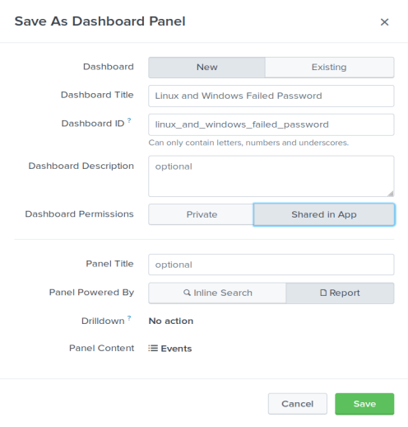
Activity Review Part 2: Creating a New Dashboard for Report
Add the report to a new dashboard:
Title = Linux and Windows Failed Password
Complete the additional fields and save the Dashboard.

Slide 47
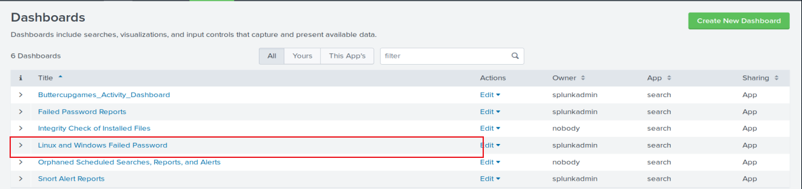
Activity Review Part 2: Creating a New Dashboard for Report
Add the report to a new dashboard:
Title = Linux and Windows Failed Passwords
Complete the additional fields and save the Dashboard.
View the Dashboard in the Dashboard List

Slide 48
Activity Review Part 3: Add Existing Search Report to a Dashboard
Add the Windows failed login search to the Linux and Windows Failed Password Reports dashboard.

Slide 49
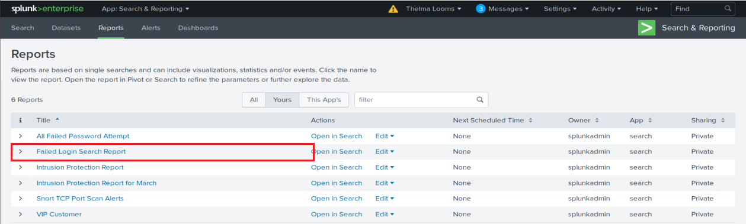
Activity Review Part 3: Add Existing Search Report to a Dashboard
Add the Windows Event failed login search to the Linux and Windows Failed Password Reports dashboard.
Review how to find a Failed Login Search Report in the Report List

Slide 50
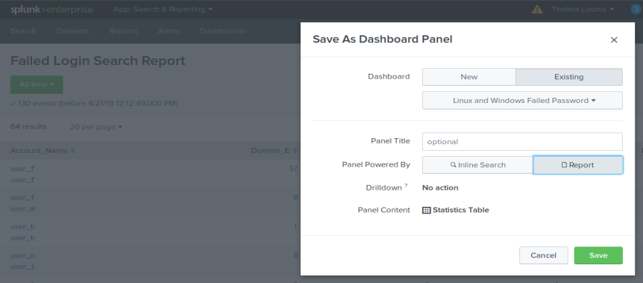
Activity Review Part 3: Add Existing Search Report to a Dashboard
Add the Windows Event failed login search to the Linux and Windows Failed Password Reports dashboard.
Add the report to the Linux and Windows Failed Password dashboard.

Slide 51
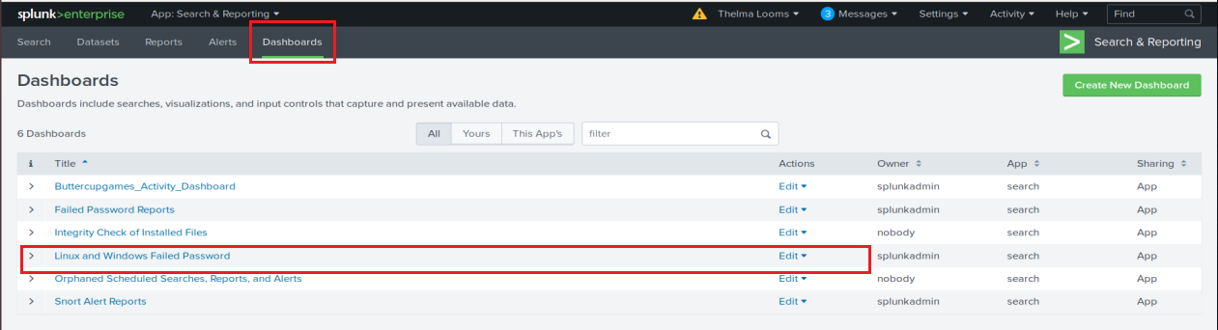
Activity Review Part 4: Edit the Dashboard
View the dashboard from the Dashboard List and click the Edit button.

Slide 52
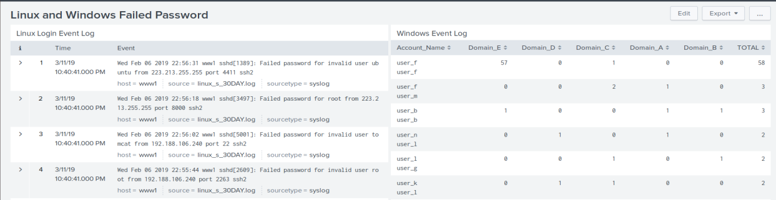
Activity Review Part 4: Edit the Dashboard
Enter titles for the dashboard panels: Linux Login Event Log and
Windows Event Log.
Drag the bottom panel so that the tables are side-by-side.
Save and redisplay the dashboard.

Slide 53

Visualizations

Slide 54
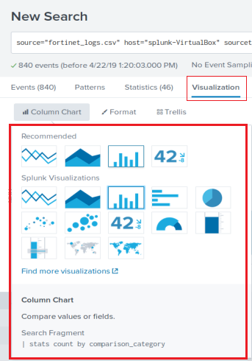
Visualizing Event Data in Splunk
We can create visualization elements such as charts, buttons and maps, and add them to our dashboards.
We have been displaying our data in the Events and Statistics tab, but Splunk provides more useful visual representations, making it easier for Security teams to analyze and interact with data during investigations and day-to-day operations.
These elements are available under the Visualizations tab, where you’ll find options like: bar, pie and bubble charts, radial and filler gauges, and geographic maps.

Slide 55
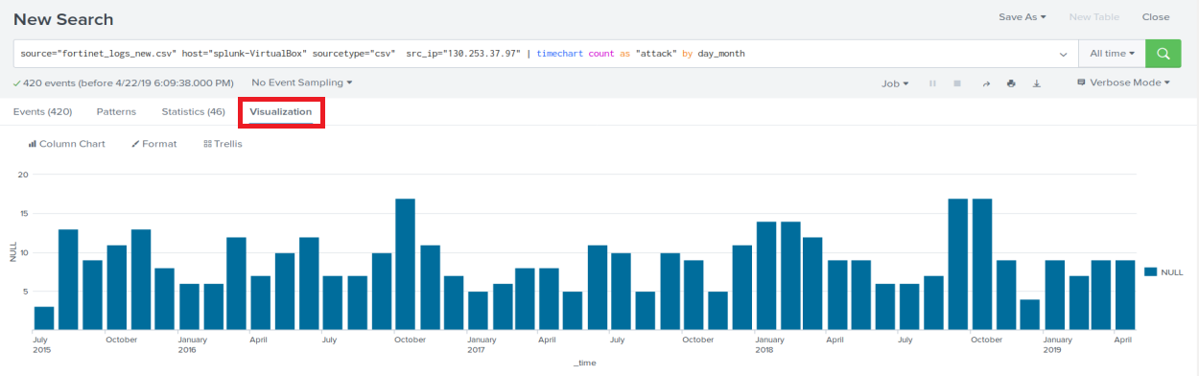
Visualization Demo: Time Chart
In this demo, we’ll create a time chart and a cluster map using event data from the Fortinet Firewall Attack Log activity.
The timechart command produces trends over time searches.
We’ll create a time chart that displays the monthly activity for all years of the attack.
| timechart count as "attack" by day_month

Slide 56
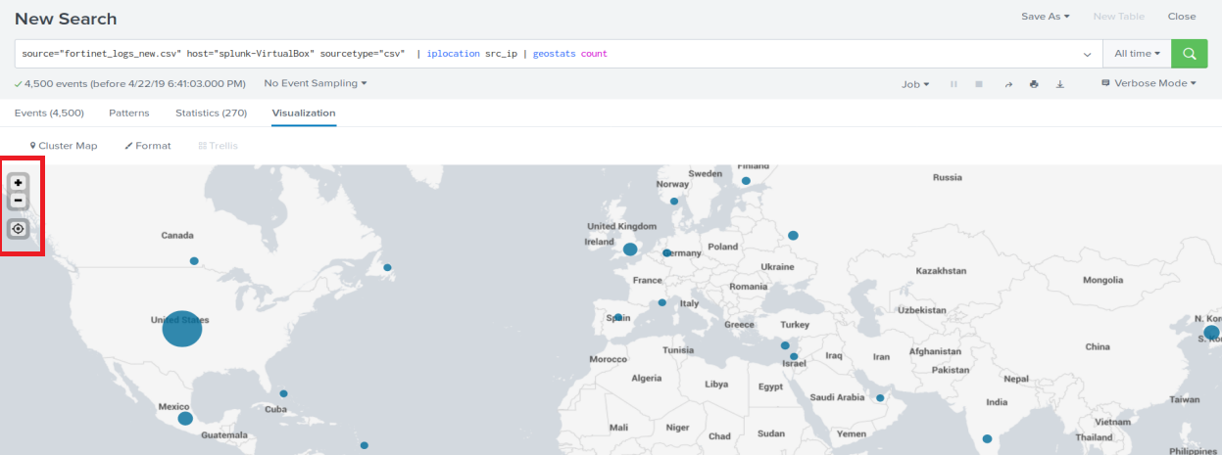
Visualization Demo: Cluster Map
We’ll use iplocation and geostats command to report on the locations of attack activities.
Iplocation command extracts local information from IP addresses.
Iplocation returns City, Country, latitude, longitude and region in event fields
Geostats command takes the IP data and generates statistics which are grouped into geographical data points that can then be rendered on a map.
source="_fortinet_logs_new.csv" | iplocation src_ip | geostats count

Slide 57
Visualizing Data from Firewall Attack Logs

Slide 58
Student Activity: Visualizing Data From Firewall Attack Logs
In this activity, you will create more visual elements and add them to dashboards for the Fortinet Firewall logs.
Instructions sent via Slack.
20 Minutes

Slide 59
Visualizing Data from Firewall Attack Logs

Slide 60
Visualizations Activity Review
Timechart: Create a timechart for the top source IP for the DOS attacks by month.

Slide 61

Visualizations Activity Review
Timechart: Create a timechart for the top source IP for the DOS attacks by month.
src_ip=<ip address> | timechart count as “attack” by day_month

Slide 62
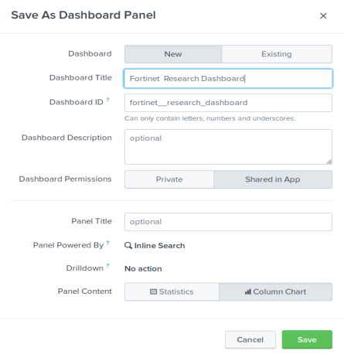
Visualizations Activity Review
Timechart: Add the timechart to a dashboard called Fortinet Research Dashboard.

Slide 63
Visualizations Activity Review
Attack Count: Generate the count (420) using the stats command.

Slide 64
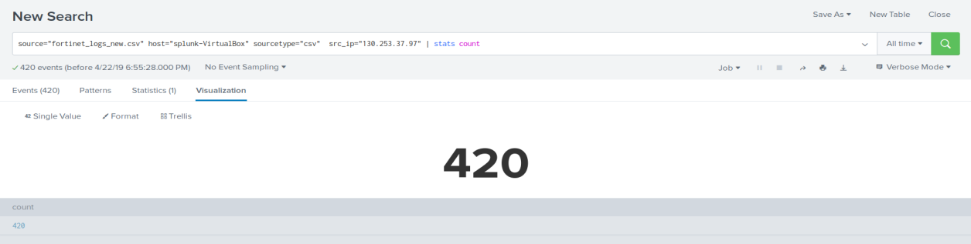
Visualizations Activity Review
Attack Count: Generate the count (420) using the stats command.
src_ip=130.253.37.97 | stats count
Then, under the visualization tab, select Single Value.

Slide 65
Visualizations Activity Review
Map: Generate a map for only the top IP source.

Slide 66
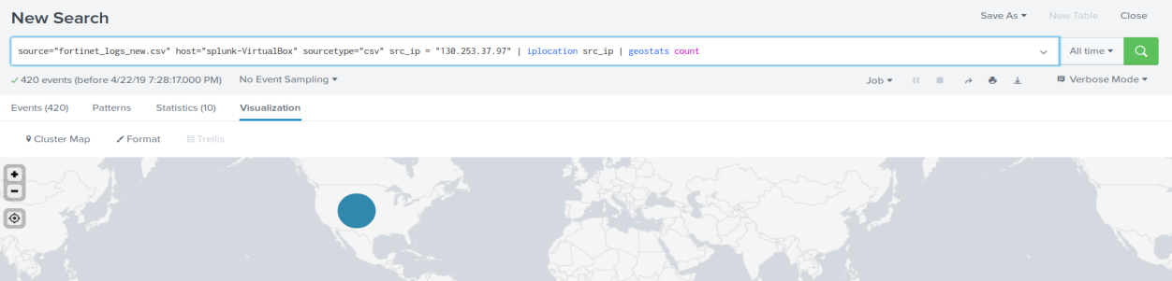
Visualizations Activity Review
Map: Generate a map for only the top IP source.
src_ip=130.253.37.97 | iplocation src_ip | geostats count

Slide 67
Visualizations Activity Review
Area Chart: Generate an area chart that displays the targets of the attack for the source IP address.

Slide 68
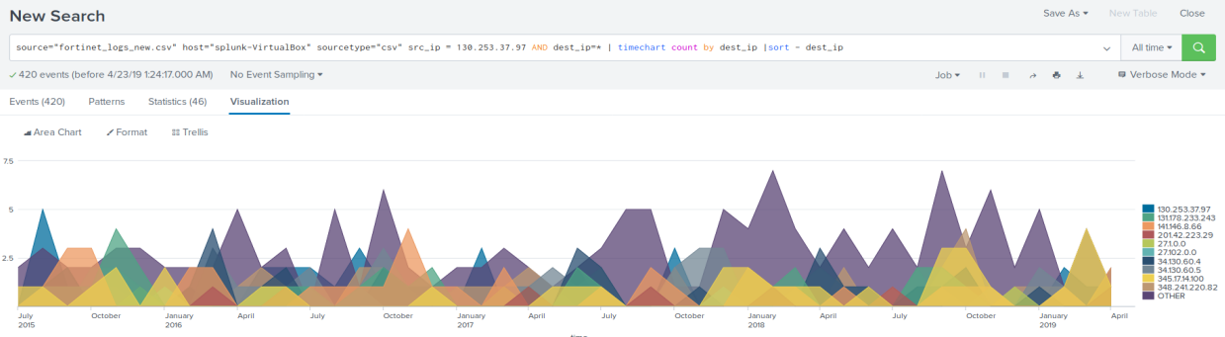
Visualizations Activity Review
Area Chart: Generate an area chart that displays the targets for the attack for the source IP address.
src_ip=130.253.37.97 AND dest_ip=* | timechart count by dest_ip | sort - dest_ip

Slide 69
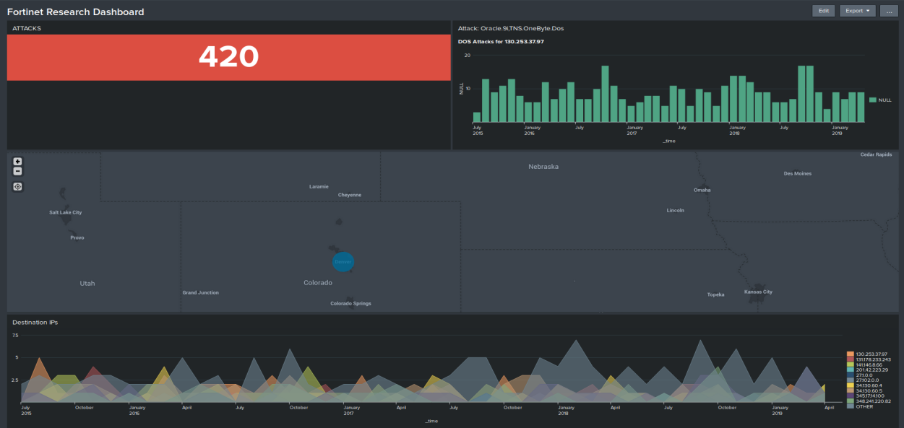
Visualizations Activity Review
User Interface: Change the color of the count to red and
the background to the Dark Theme.
The title for the count panel is called Attacks.
Most SOCs and NOCs prefer dark backgrounds.
These elements can be changed after the search is generated.

Slide 70
Visualizations Activity Review
Where are the attacks originating?
Zoom in and you’ll see....

Slide 71
Visualizations Activity Review
Where are the attacks originating?
Zoom in and you’ll see DENVER

Slide 72
Class Objectives
By the end of class today, you will be able to:
Use Splunk’s documentation to implement new search commands.
Generate and use reports from Intrusion Prevention System logs.
Perform statistical analysis based on event information.
Demonstrate how dashboards are used to accelerate time-to-insight and time-to-action.
Use visualization to compare and aggregate event field data.

Slide 73
Any Questions?

